Slide 1

Competitive Programming From Problem 2 Solution in O(1)
P
T
H
I
N
K
F
A
S
T
S
C++: Structures
Mostafa Saad Ibrahim
PhD Student @ Simon Fraser University

Slide 2
Motivation
Think in company where you have emplyee, where each one defined as
Name, salary, address, email
If we want to store N employees, we need 4 arrays to hold such data. However, this is not convienent.
Image we need to sort based on name?
Remove employee?
Imagine one more entry added: e.g. position

Slide 3
Structure
A structure is a user-definable type
int or float are defined for us
But we define struct for our needs
A structure element is one that contains many sub-elements. So we can have a an employee structure that holds all needed information
Once defined, we can “almost” use it as built-in types. E.g. Define element or array of it

Slide 4
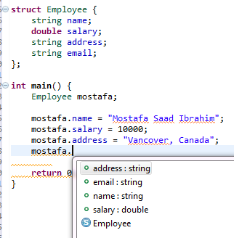
Structure
External declaration.
Can be internal too
Ctr + space
For auto complete

Slide 5
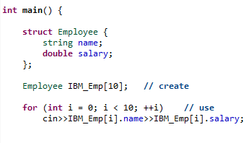
Structure

Slide 6
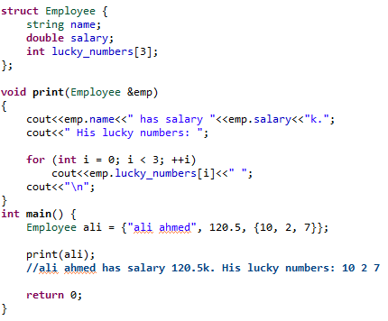
Structure

Slide 7
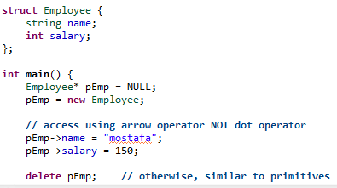
Structures: Pointers

Slide 8
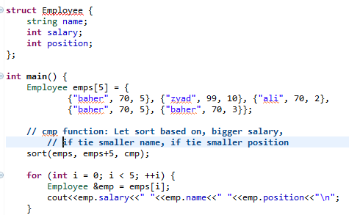

Structure: sorting

Slide 9
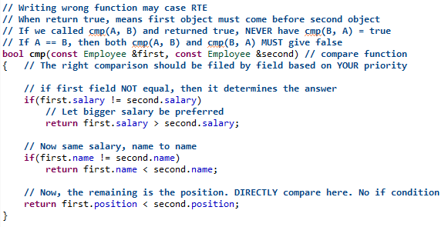
Structure: sorting
Strict Weak Ordering

Slide 10
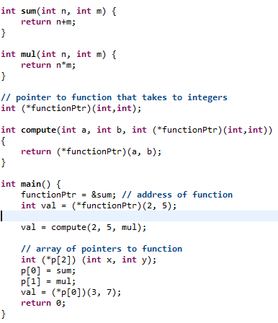
Offtopic: Pointer to function

Slide 11
Data structure alignment
Data structure members are stored sequentially in memory
E.g. Name before salary which before position
However, this doesn’t mean they are directly sequential. For some reasons, compile may add internal elements between the fields. They are hidden. So never play in internal memory of structure.

Slide 12
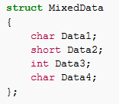
Data structure alignment
Imagine we defined this structure,
How may be really in memory?
Src: https://en.wikipedia.org/wiki/Data_structure_alignment#Typical_alignment_of_C_structs_on_x86

Slide 13
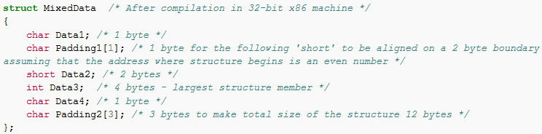
Data structure alignment
For further understanding why so, Read about “Data structure alignment”

Slide 14
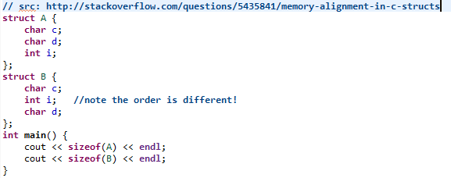

Data structure alignment

Slide 15
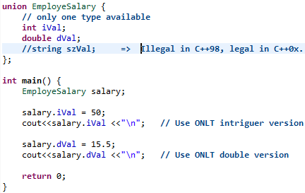
Unions

Slide 16
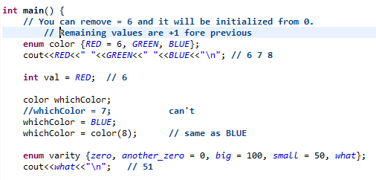
Enums

Slide 17
تم بحمد الله
علمكم الله ما ينفعكم
ونفعكم بما تعلمتم
وزادكم علماً

